Slide 1

Earthquake Sensor with Arduino UNO
Atakan Ük
&
Mehmet Beraat Sağın

Slide 2
Presentations Topics
Problems & Solutions
Hardware/Software Problems
Description of Project Components
Circuit Schema
Results
Outcome: What we have learned?

Slide 3
Problems & Solutions: Hardware/Software
Our MPU-6050 was not connecting to the board directly so we had to solder cable to it. Then we connected to breadboard.
We tried to put some delay between alarms with delay function but it caused a lag problem in graph, so we used the milis function and everything was much smoother.

Slide 4
In our first program we were signalling the buzzer and the led from 9th and 10th ports but it was not working, only 9th port was working, so we made a connection to the led from 9th port. After that we changed our code implemantation and we found out that it was a variable problem, that we were sending LOW signal from the port and we corrected it.

Slide 5
We show the intensity of earthquake with leds, but two of the leds were not working. Later we found out that leds were not defined in the setup section. So we defined them and the problem was solved.

Slide 6
Description of Project Components
Arduino UNO: It is a microcontroller board based on the ATmega328P. It has 14 digital input/output pins (of which 6 can be used as PWM outputs), 6 analog inputs, a 16 MHz quartz crystal, a USB connection, a power jack, an ICSP header and a reset button. It contains everything needed to support the microcontroller; simply connect it to a computer with a USB cable or power it with a AC-to-DC adapter or battery to get started.

Slide 7
MPU-6050: It is a six-axis IMU sensor card which includes a triaxial gyro, a triaxial angular accelerometer and often used in various hobby, multicopter and robotic project. The card works between 3 and 5 V supply. Both of accelerometer and gyro outs give I²C outs from different channels. It can give a 16-bits resolution out on each axis. With standart located pinouts it can be used with breadboard and different circuit cards easily.
Operation voltage: 3-5V
Gyro measurement range: + 250 500 1000 2000 ° / s
Angular accelerometer measurement range: ± 2 ± 4 ± 8 ± 16 g
Channel: Standard I²C

Slide 8
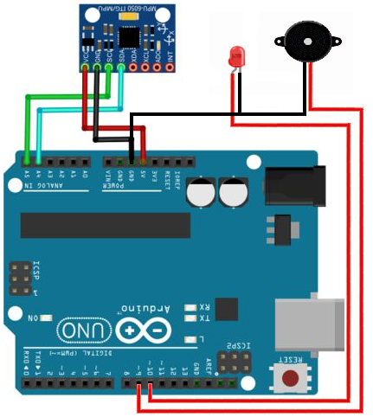
Circuit Schema
Components:
Arduino UNO
MPU-6050
Led
Buzzer

Slide 9
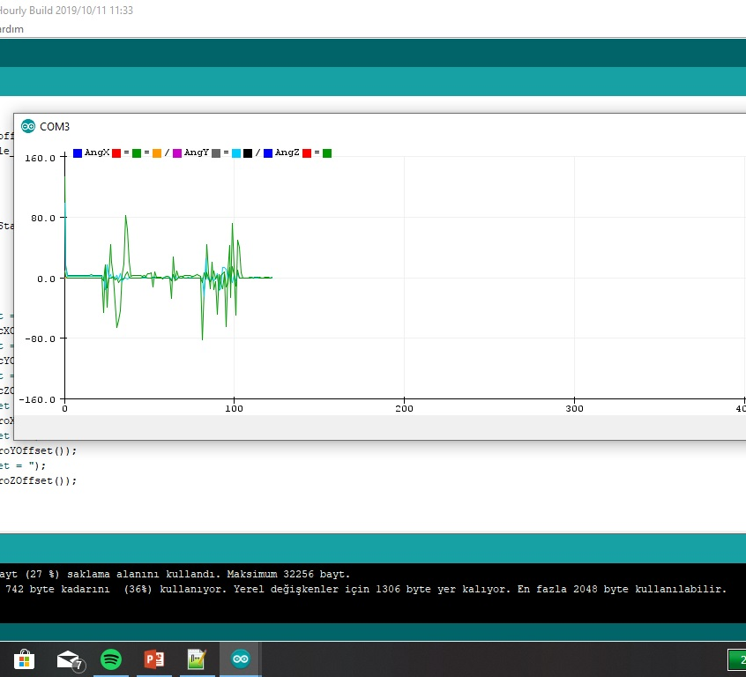
Results
You can see the waves on the live graph. It changes depend on vibrations on the chip’s basement. MPU6050 senses vibrations on X,Y,Z dimensions and converts mechanial inputs to digital.

Slide 10
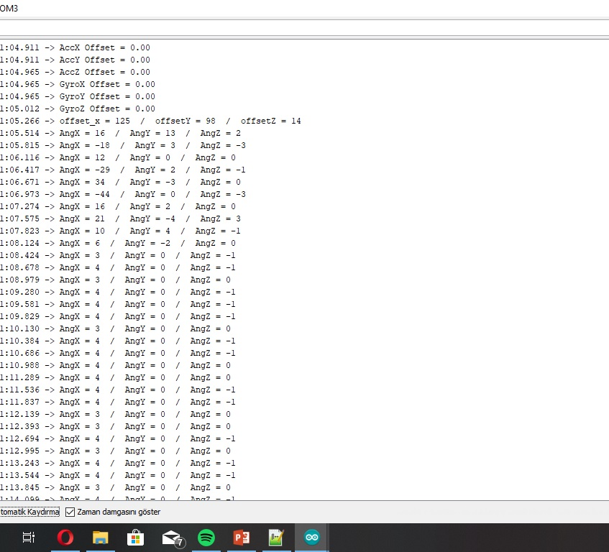
This live table shows the values of every dimensions (X,Y,Z). We have used these values to trigger LED and BUZZER.

Slide 11
Outcome: What we have learned?
We learned about;
the usage of MPU6050 chip,
how to use milis and delay functions,
how to solder.
Recommendations:
Stabilize the chip on a solid object.
Don't use delay function (it causes lag on graph).
Solder the cables to the chip properly.

